Slide 1




21.10 Release
@RAPIDSai
https://github.com/rapidsai
https://rapids-goai.slack.com/join
https://rapids.ai
Notes:
https://rapids.ai/ https://github.com/rapidsai
https://docs.rapids.ai/overview

Slide 2
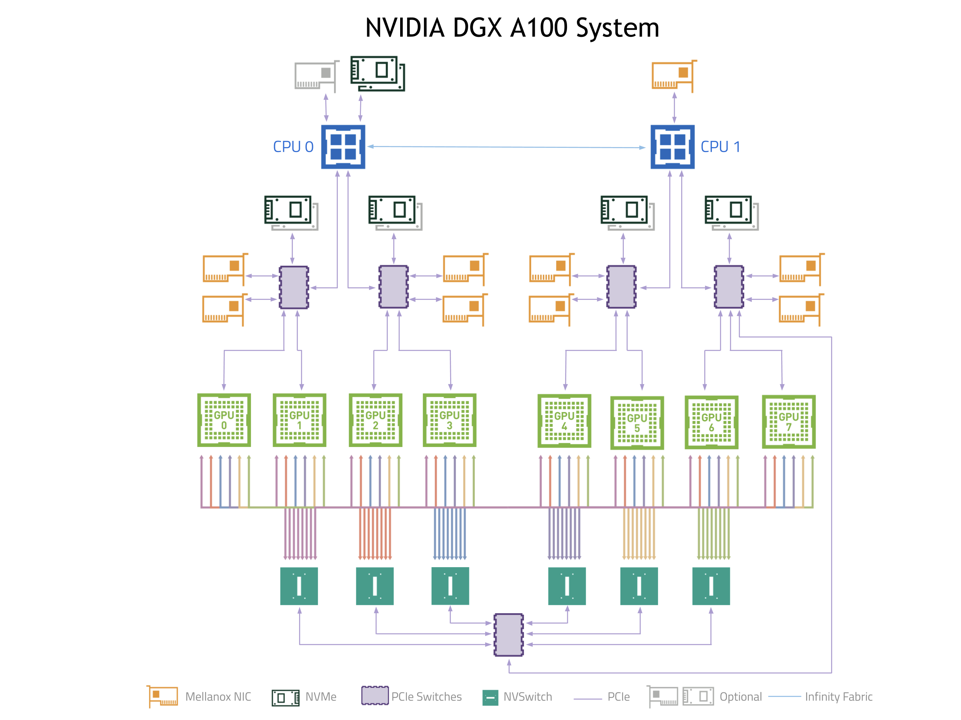
Why GPUs for Data Science?
Numerous hardware advantages
Thousands of cores with up to ~20 TeraFlops of general purpose compute performance
Up to 1.5 TB/s of memory bandwidth
Hardware interconnects for up to 600 GB/s bidirectional GPU <--> GPU bandwidth
Can scale up to 16x GPUs in a single node
Almost never run out of compute relative to memory bandwidth!

Slide 3
What is RAPIDS?
End-to-End GPU Accelerated Data Science
Data Preparation/ETL
Analytics/ML/Graph
Visualization
cuDF
GPU-accelerated ETL functions
Tracks Pandas and other common PyData APIs
Dask + UCX integration for scaling
RAPIDS ML
GPU-native cuML library, plus XGBoost, FIL, HPO, and more
cuGraph
GPU graph analytics, including TSP, PageRank, and more
cuxfilter
GPU-accelerated cross-filtering
pyViz integration
Plotly Dash, Bokeh, Datashader, HoloViews, hvPlot
Domain-Specific Libraries
CLX + Morpheus Cyber log processing + anomaly detection | cuSignal Signals processing | cuSpatial Spatial analytics
cuStreamz Streaming analytics | cuCIM Computer vision & image processing primitives | node-RAPIDS Bindings for node.js
...and more!

Slide 4
Overview of Changes: RAPIDS 21.10 Release
RAPIDS CUDA 11.4 now supported by RAPIDS
RAPIDS+Dask Support for LocalCUDACluster with MIG; UCX 1.11.1 support
cuDF Map support for ORC Reader; struct support for ORC write; Time series enhancements including support for rolling and grouped rolling variance and standard deviation, groupby first and last aggregations, and datetime manipulations like ceil and days_in_month;
cuML New Categorical and Gaussian Naive Bayes models; categorical features support in FIL; improvements to ARIMA, Random Forest and HDBSCAN; new distances added to pairwise_distances; 2d kNN acceleration via RBC
cuGraph New Sorensen coefficient and weighted Sorensen coefficient features; Biased Random Walks sampling for Graph Neural Networks support added to libcugraph; Improved graph primitives for better memory scaling and multi-node multi-GPU memory footprint improvements for low average vertex degree graphs; Multi-seed BFS, one seed per component, added.
CLX Maintenance to existing code; DGA extended sequence handling; additional notebooks for new use cases
cuCIM Support Runtime Context for CuFileDriver and CuImage; Support raw RGB tiled TIFF

Slide 5
cuDF Updates: Deep Dive
Release 21.10
Features added in 21.10
Map support for ORC Reader and struct support for ORC writer
Struct support for drop_list_duplicates in libcuDF
LibcuDF added interleave_columns function for struct and lists
Rolling and grouped rolling variance and standard deviation, and groupby first and last aggregations
Linear interpolation for filling missing values
Computing t-digests and approximate percentiles
Planned Upcoming Features
Expanded support for additional decimal types
Nested type support for JSON reader
Enhanced GPUDirect Storage integration
Map support for ORC writer
Refactored hash join implementation
Notes:
Medium blog title : Lookout, nested types are now supported in RAPIDS cuDF!

Slide 6
cuML Updates: Deep Dive
Release 21.10
Features added in 21.10
Categorical features support in FIL
Single-GPU implementation of Categorical and Gaussian Naive Bayes algorithm
2-Dimensional Random Ball Cover algorithm for speeding exact Nearest Neighbors
Added support for hamming, jensen-shannon, kl-divergence, correlation and russellrao distances for pairwise distance calculations
Support for missing observations, padding and exogenous variables for ARIMA
Multiple improvements to Random Forest to improve accuracy and performance.
Planned Upcoming Features
Support for exogenous variables in ARIMA and updates for confidence intervals and Kalman filter
Exposing KL divergence in TSNE
Optimized Linear SVM

Slide 7
cuGraph Updates: Deep Dive
Release 21.10
Features added in 21.10
Single-GPU implementation of Sorensen coefficient and weighted Sorensen similarity coefficient.
Added Biased Random Walks for Graph Neural Networks in libcuGraph
Improved graph primitives to support better memory scaling, as well multi-node multi-GPU memory footprint improvements for low average vertex degree graphs
New end-to-end benchmarking scripts
Resolve tech debt and enhance the library
Multi-seed BFS, allow one seed per connected component, add
Planned Upcoming Features
Multi-GPU graph primitives for Triangle Counting, Symmetrize, and Transpose
Multi-GPU HITS
SG node2vec graph sampling

Slide 8




Join the Conversation
GOOGLE GROUPS
DOCKER HUB
SLACK CHANNEL
STACK OVERFLOW
https://groups.google.com/forum/#!forum/rapidsai
https://hub.docker.com/r/rapidsai/rapidsai
https://rapids-goai.slack.com/join
https://stackoverflow.com/tags/rapids

Slide 9
THANK YOU
@RAPIDSai
Notes:
https://rapids.ai/ https://github.com/rapidsai
https://docs.rapids.ai/overview

